Slide 1
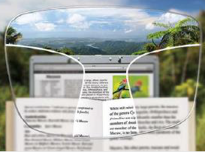
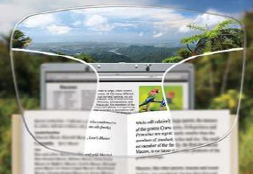
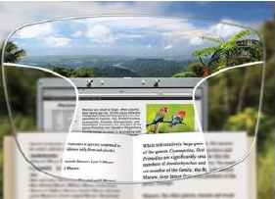

PROGRESSIVE LENS PACKAGE
Practice Name
DIGITAL LENSES
BASIC PACKAGE
STANDARD PACKAGE
PREMIUM PACKAGE
The difference
is clear
Digital lenses are 6 times more accurate than traditional lenses and offer up to 20% wider vision channels.
Think of them like your HD TV, the more pixels the crisper the picture with unmatched depth and clarity.
Everyone can benefit from the accuracy of digital lenses, especially those with a higher prescription, large amounts of astigmatism or progressive lens wearer.
Package Includes:
Feature 1
Feature 2
Feature 3
Package Includes:
Feature 1
Feature 2
Feature 3
Package Includes:
Feature 1
Feature 2
Feature 3
$xxx.xx
$xxx.xx
$xxx.xx
ADD-ON’S
Add-On Option 1
$xx.xx
Add-On Option 3
$xx.xx
Add-On Option 2
$xx.xx
Add-On Option 4
$xx.xx

Slide 2
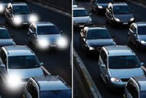
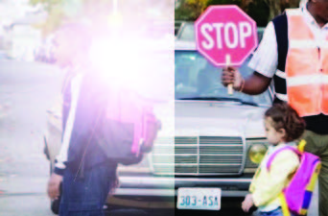


Additional Assets
NON-GLARE
LENSES
POLARIZED
LENSES
TRANSITIONS
LENSES
SUNSYNC
LENSES
Enhance the look and performance of your glasses
With non-glare lenses, you can experience the most precise, crisp and clear natural vision in a brilliance that is not possible with uncoated lenses.
Non-glare coatings repel water, fingerprints, oil and dirt, keeping your lenses clean for longer periods of time.
Non-glare coatings reduce the glare allowing others to see your eyes instead of distracting reflections on your lenses.
High quality vision in the sun
Polarized lenses block the harsh light that bounces off surfaces such as cars and water, leaving you with clear and crisp vision along with improved contrast and depth perception.
Polarized lenses are a safe and healthy option for everyone. Because polarized lenses minimize blind spots and help your eyes easily adjust to varying light conditions, you will experience reduced eye strain and eye fatigue while wearing polarized lenses.
Be ready no matter what light you’re in
You’re inside. You’re outside. Your daily life keeps you moving back and forth between light and bright sunshine. When your lenses seamlessly adapt to every situation, you always see life in the best light.
Transitions lenses block 100% of UVA/UVB rays while helping protect your eyes from Harmful Blue Light both indoors and out.
Change is good
SunSync Light-Reactive lenses are dark when you need them and clear when you don’t.
SunSync Light-Reactive lenses defend your eyes against ultraviolet radiation and blue light.
Additionally, you’ll have the precision and clarity of corrective lenses, the comfort and protection of outdoor lenses, and the joy of never having to fumble between glasses again.

Slide 3
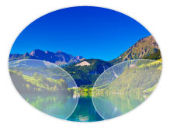


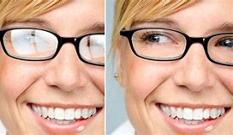
Additional Image Assets
Basic Option
Standard Option
Premium Option
Non-Glare

Slide 4
Additional Text Assets
Basic Option
Standard Option
Premium Option
Digital lenses for smooth, gradual movements when changing focus from far to near
Distance ★★★
Intermediate ★★
Near ★★★
Advanced digital technology
For smoother movement and wider fields of vision.
Distance ★★★★
Intermediate ★★★
Near ★★★
Personalized digital technology for precise and perfected vision to enhance viewing in all areas, including digital devices.
Distance ★★★★★
Intermediate ★★★★★
Near ★★★★★
CONVENTIONAL PROGRESSIVE
Older Technology
Reduced Edge to Edge Clarity
Not Customizable
Thicker Appearance
DIGITAL
PROGRESSIVE
Freeform Design
Better Performance
Improved Edge to Edge Clarity
Wider Field of Vision
Highest Level or Optical Accuracy (Up to 1/100 of a diopter)
Better Aesthetics

